Slide 1
Front End Engineering-II (FEE)
22CS014
Submitted by:
Dhruv Sehgal (2210990277)
Devansh Mittal (2210990260)
Dhruv Kinger (2210990275)
Devang Saini (2210990257)
Supervised by:
Ms. Shalini Kumari
Department of Computer Science and Engineering
Chitkara University, Punjab

Slide 2
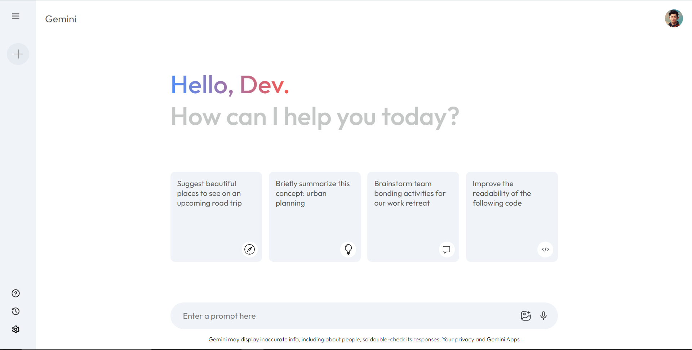
About
Gemini Clone
In this project, we'll delve into the creation of a Gemini clone, a large language model interface similar to Bard, ChatGPT, using React.js. We'll explore the core concepts of React.js, its application in building our Gemini clone, and the key functionalities we'll incorporate.

Slide 3
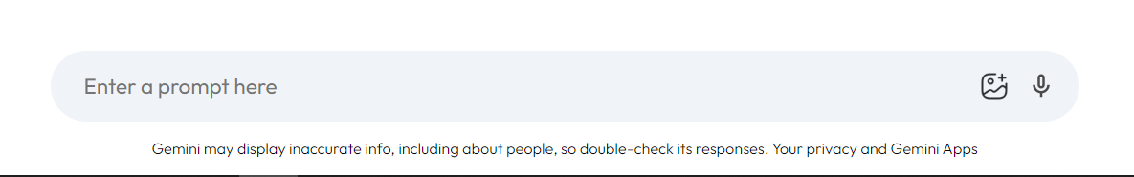
Key Functionalities
User Input Field: Accepts user queries and prompts
Large Language Model Integration: Connects to a large language model API (e.g., Bard) to process queries
Response Display: Presents the generated responses from the large language model in a clear and user-friendly format
Error Handling: Gracefully handles errors during API communication or model response
Our Gemini clone will provide a user input field where users can type their questions or prompts. Upon submission, the query will be sent to a large language model API, potentially Bard or a similar service. The response received from the API will be displayed in a designated area of the UI.

Slide 4
API
What is an API
An API, which stands for Application Programming Interface, acts as a middleman between different software programs. It allows them to talk to each other and exchange data or functionality.
In the world of computers, APIs are essential for building applications that work together. They allow developers to take advantage of existing features without having to rewrite everything from scratch. For instance, many travel websites use airline APIs to search for flights and check prices. The travel website doesn't need to have its own database of flights - it can simply query the airline's database through the API.

Slide 5
Approach
Project Setup: Establish development environment with tools like Node.js, npm, and a code editor
Component Creation: Develop reusable components for UI elements (input, response, etc.)
API Integration: Integrate with a large language model API using libraries like Axios or Fetch
UI Design: Implement an intuitive and user-friendly interface using CSS or styling libraries
To get started, we'll set up our development environment, ensuring we have Node.js, npm (Node Package Manager), and a preferred code editor installed. Next, we'll delve into component creation, defining reusable React components for the input field, response area, and other UI elements. We'll then integrate with a large language model API using suitable libraries to send user queries and retrieve responses. Finally, we'll focus on UI design, crafting an attractive and user-friendly interface using CSS.

Slide 6
Thank You

